Slide 1
Jumpman jumpman jumpman I’ve got a quick question

Slide 2
How are things going in New York?
Discovery
How many deliveries were made?
How do deliveries change week to week?
How many deliveries per day?
What time are deliveries being requested most often?
How are deliveries made?
How long do deliveries take?
What is the delivery distance?
Where are the vendors and customers?
Who are the customers?
Quality
How long does each delivery take?
Is time wasted?

Slide 3
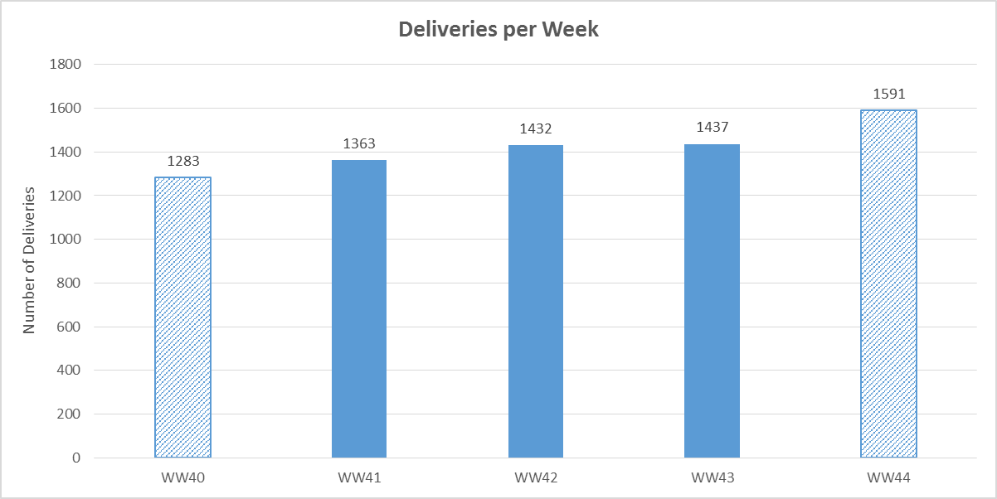
How many deliveries were made?
Note: WW40 and WW44 represent a projected number for deliveries made based on delivery volumes seen within the dataset.

Slide 4
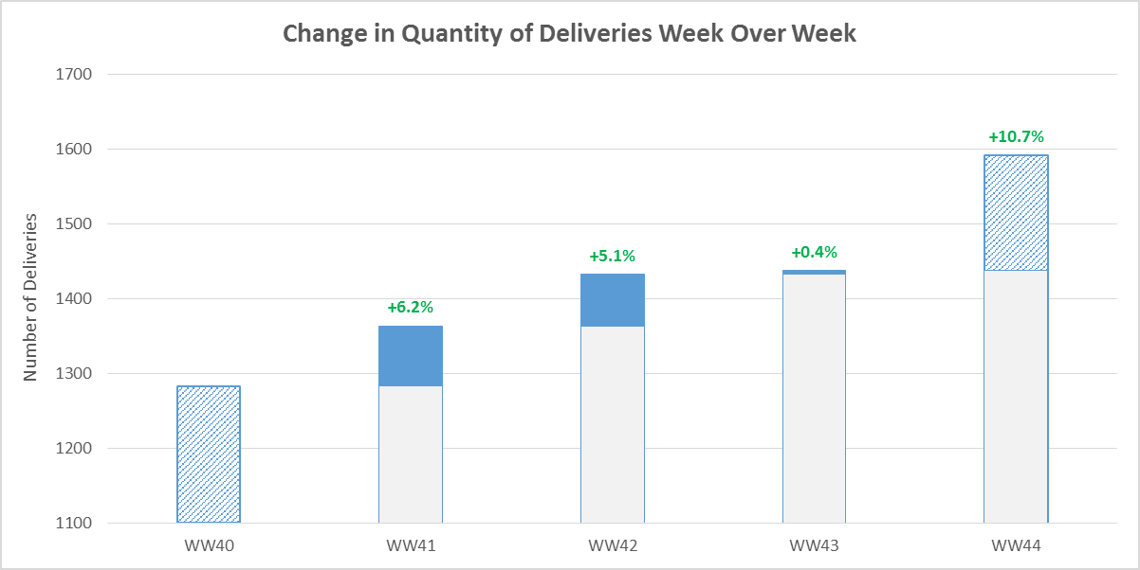
How do deliveries change week to week?
In the month of October the number of deliveries increased for each week – percentage growth from the previous week is shown.
Note: WW40 and WW44 represent a projected number for deliveries made based on delivery volumes seen within the dataset.

Slide 5
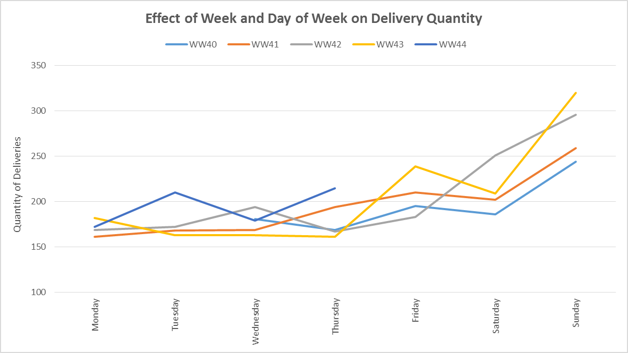
Deliveries (by day of week)
There are the most deliveries during the days of the week associated with the weekend – Sunday in particular seeing greater than 50% more deliveries when compared to the average of the other six days of the week. This trend has been steady for all weeks in the dataset.

Slide 6
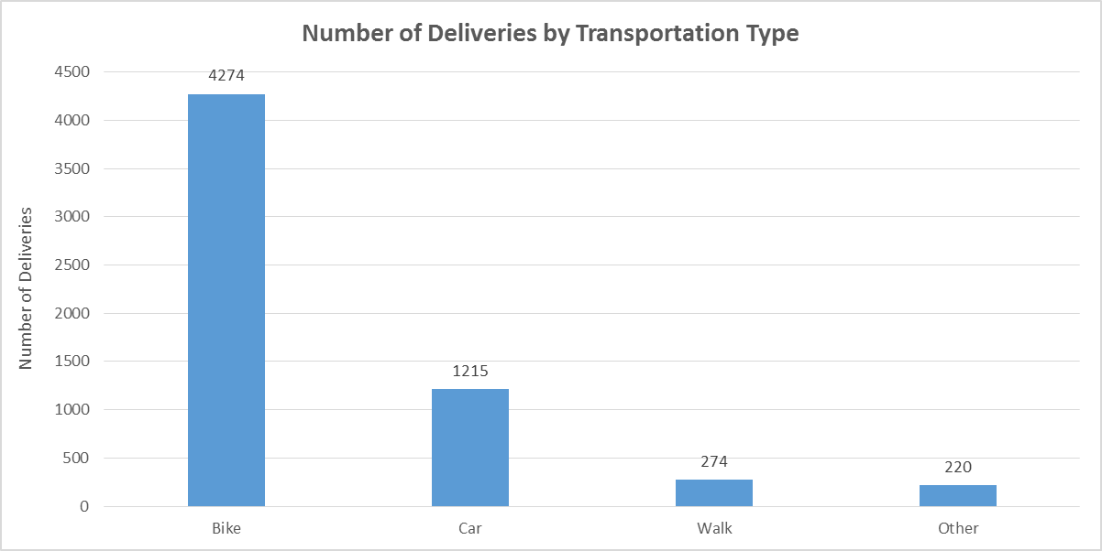
How are deliveries made?
Bike deliveries make up greater than 70% of all deliveries.

Slide 7
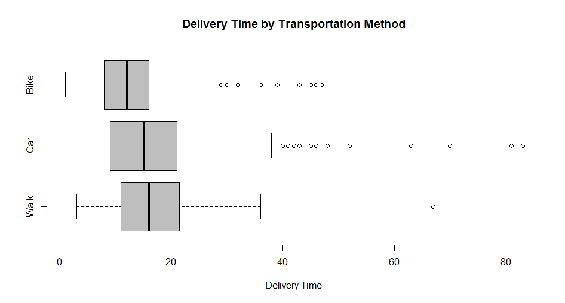
How long do deliveries take?
Median values for bike, car, walk

Slide 8
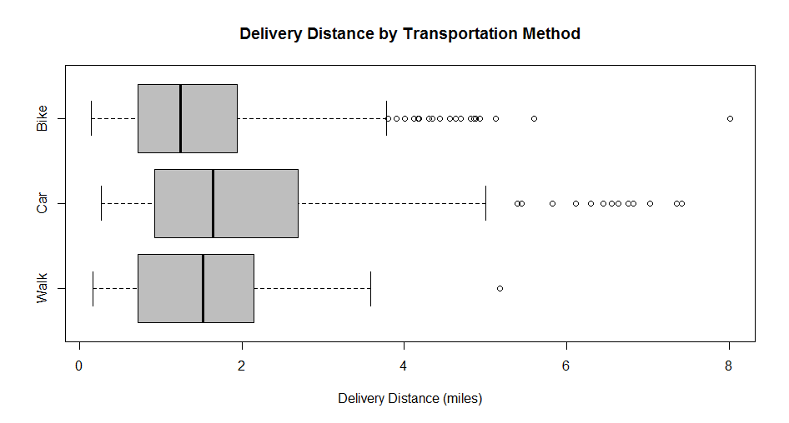
What is the delivery distance?
The median delivery distance by walking is longer than that of bikes – this may be an opportunity to

Slide 9
Maps
Contour of where the vendors are
Contour of where the deliveries are being made to
Sort by top “place_category” numbers
Contour of types of delivery
mapdist
Distances for Google-determined routes

Slide 10
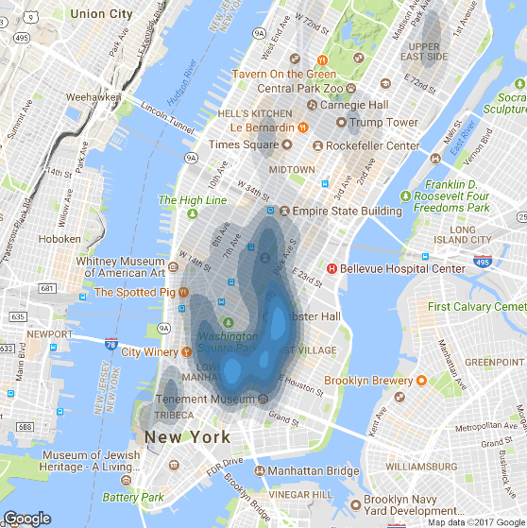
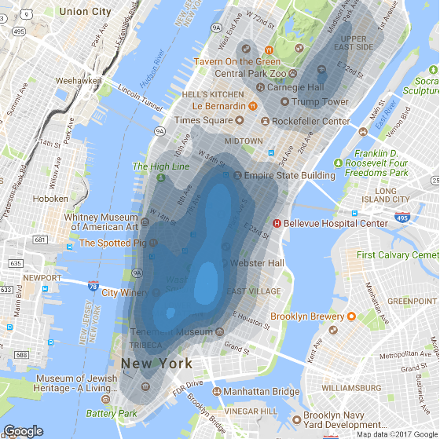
Where are the vendors and customers?
Vendors are concentrated around the Nolita, Bowery, and East Village districts in Manhattan
Customers are concentrated around the Greenwich Village and Upper East Side neighborhoods in Manhattan
Vendor Locations
Customer Locations
Credit: David Kahle, Hadley Wickham. “ggmap: Spatial Visualization with ggplot2” <http://stat405.had.co.nz/ggmap.pdf>

Slide 11
Who are the customers?
Census data shows that the population in the areas where the highest number of drop-offs occur is proportionally larger in terms of the “White, non-Hispanic” population compared to the rest of Manhattan
Census data shows that the population in the area where the highest number of drop-offs occur is wealthier than the rest of Manhattan
Landmarks within the areas where the highest number of drop-offs occur include many of the most attended colleges and universities in Manhattan

Slide 12
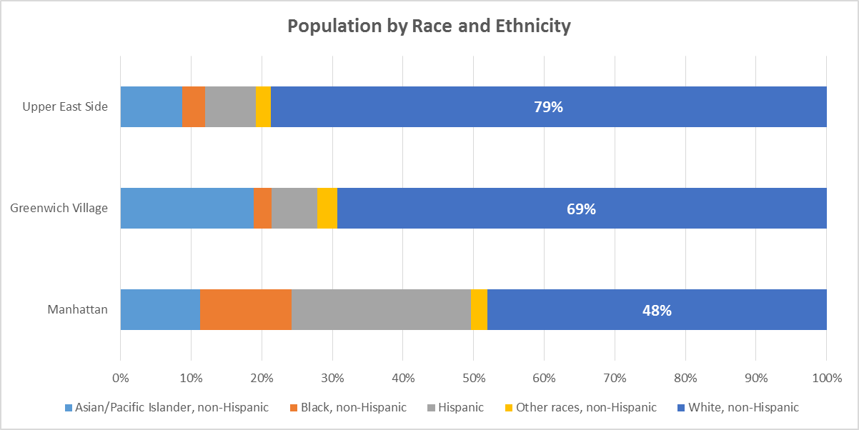
Who are the customers?
Areas where the majority of drop-offs occur show a large “white, non-Hispanic” population – 79% and 69% compared to 48% for the entirety of Manhattan.

Slide 13
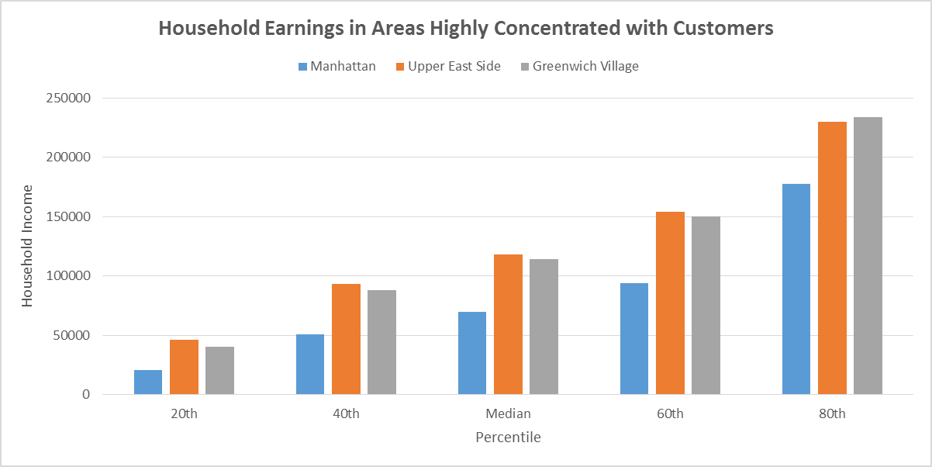
Who are the customers? (cont.)
Census data shows that the population in areas with the highest number of deliveries has median household earnings that are greater than 60% higher than that of the entirety of Manhattan.

Slide 14
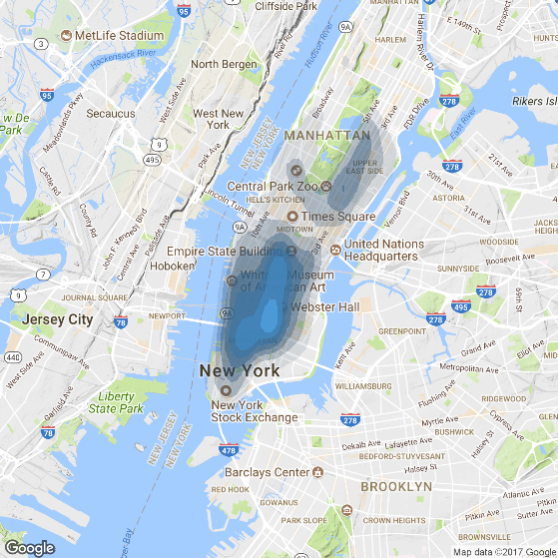
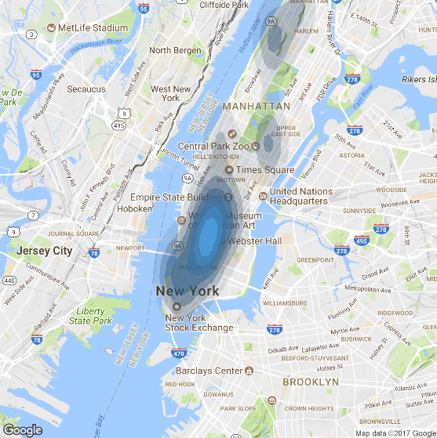
Who are the customers? (cont.)
A contour map of the list of the top 10 most highly attended colleges in Manhattan weighted by college size closely resembles the contour map of customer location.
Customer Locations
Locations of Colleges

Slide 15
Data Integrity

